Slide 1
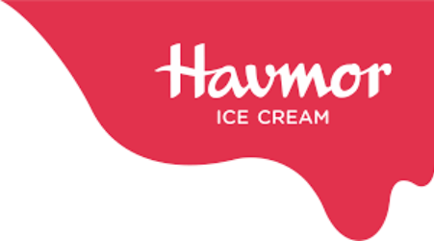
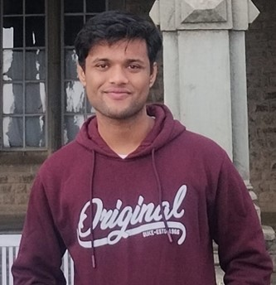

HAVMOR ANALYSIS
ARC PRABH
EVENTIVE – IIM RAIPUR

Slide 2


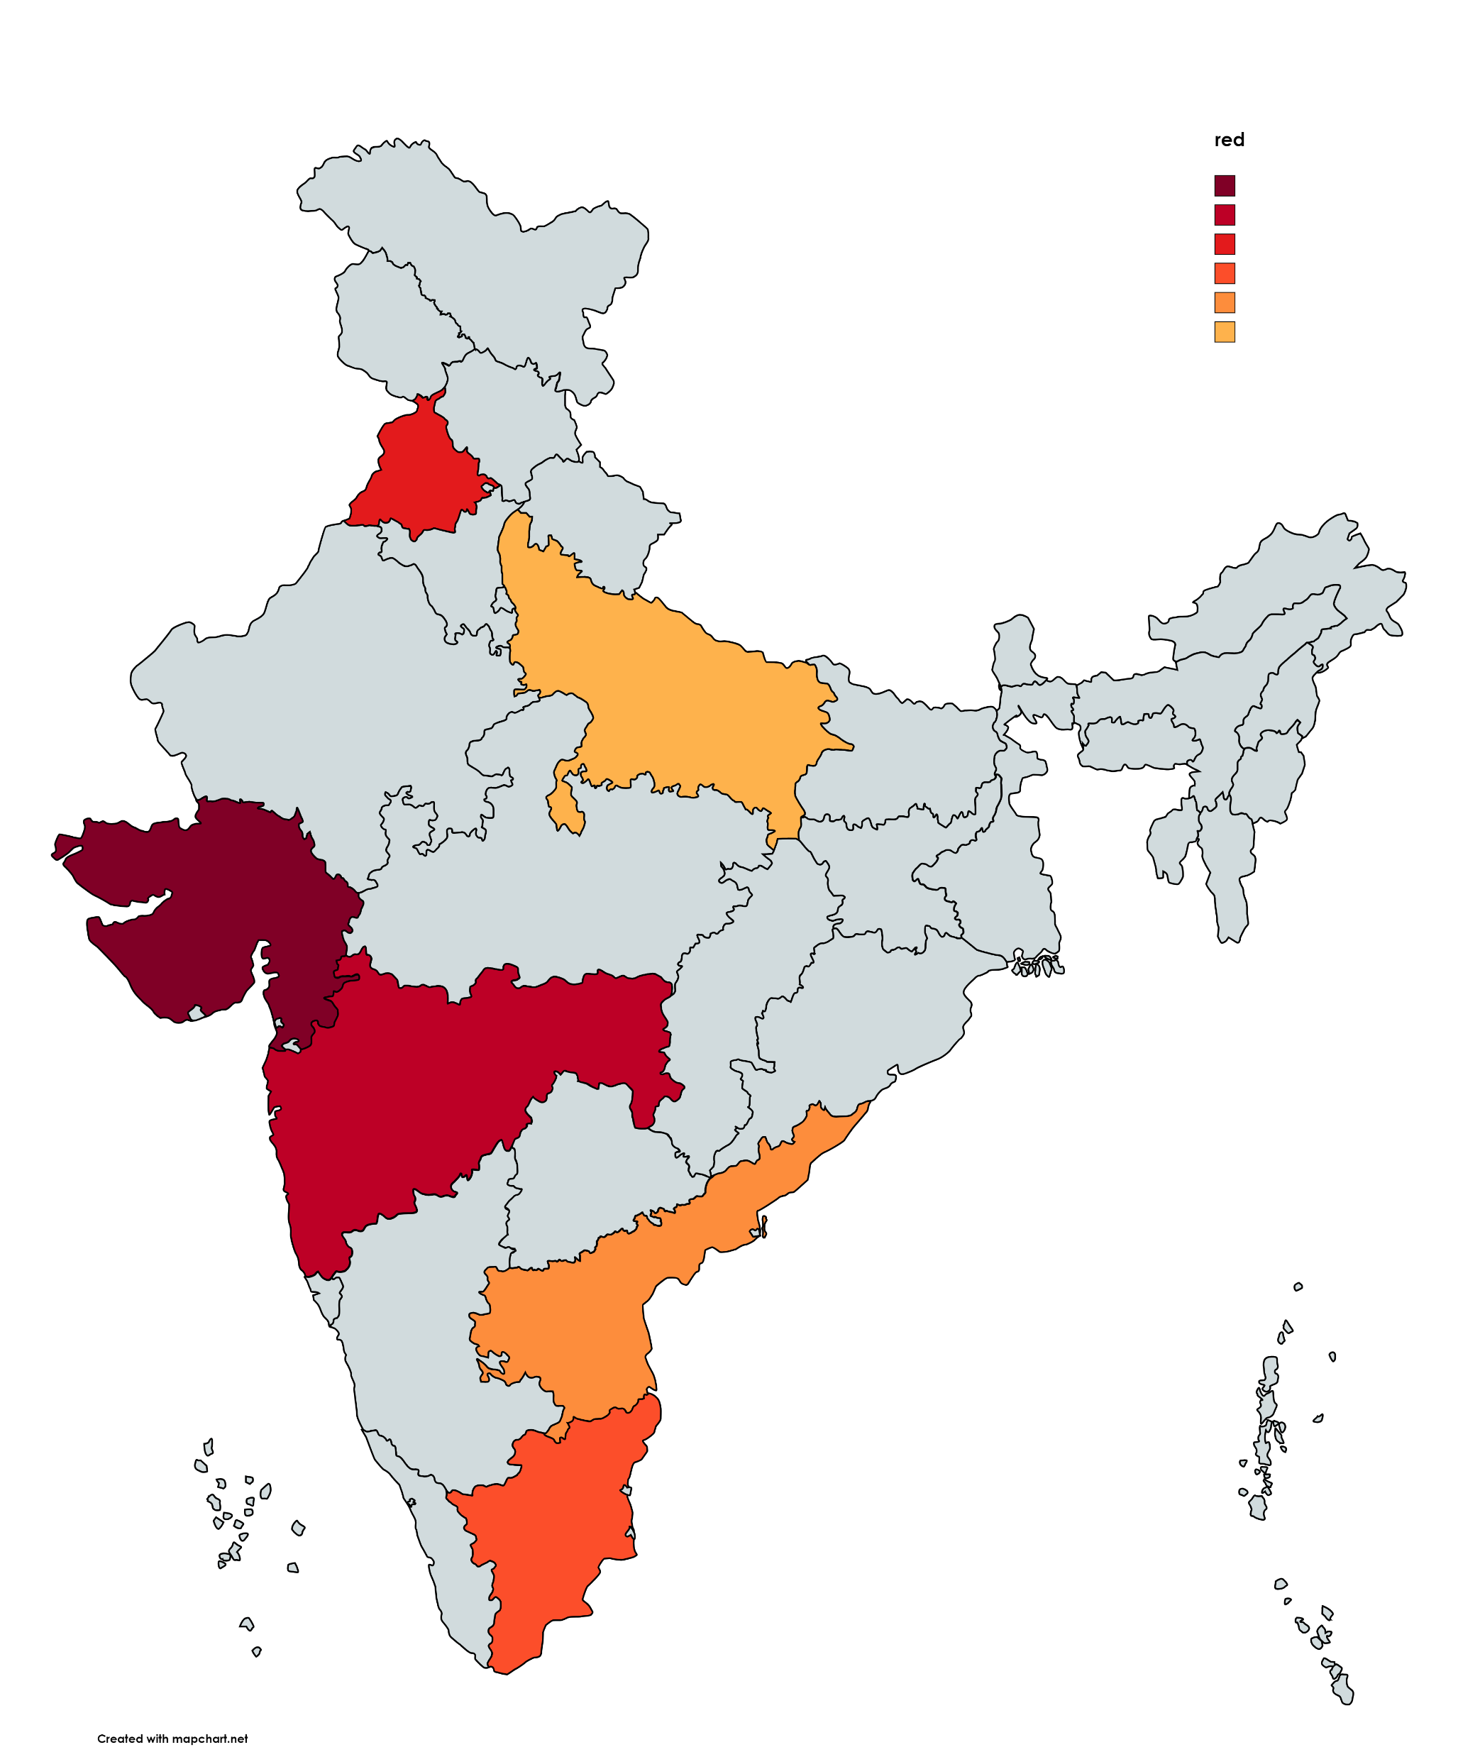

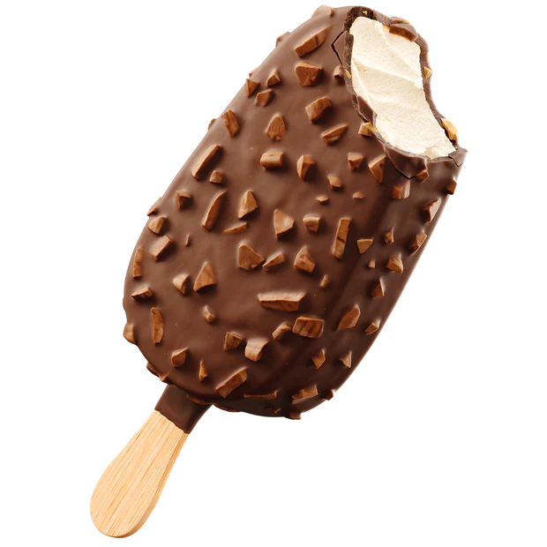
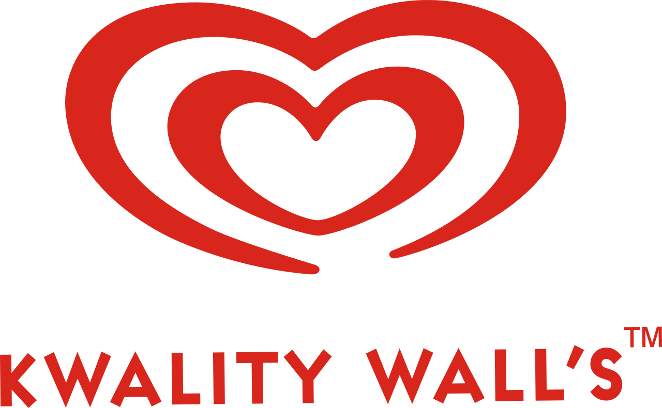

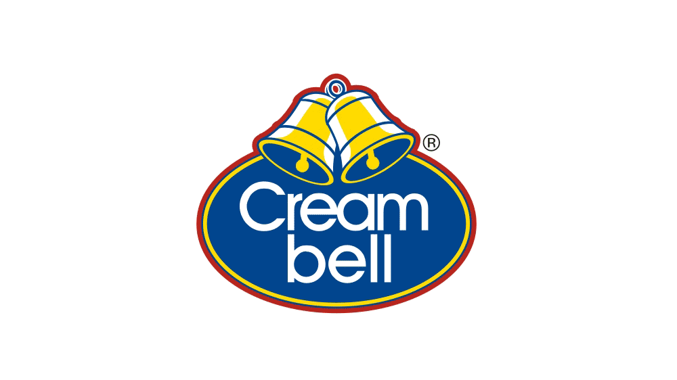

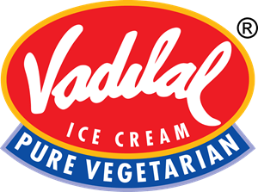
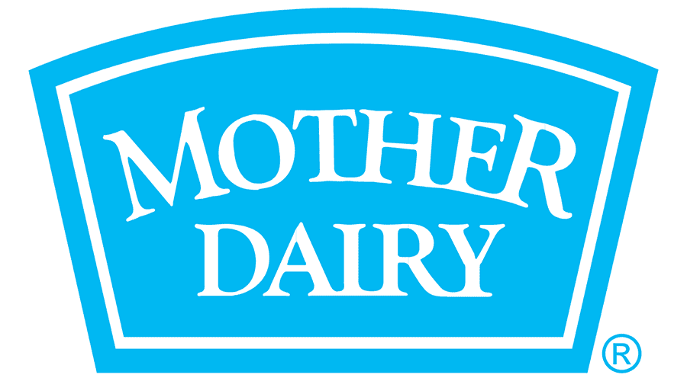
Indian ice cream market
Leading ice cream production States in india
Market Overview
Key Performance Indicators (KPIs)
New customer acquisition
Customer retention rate
product return rate
Production capacity utilization
Distribution/retailer coverage
On-time delivery percentage
Warehouse inventory turns
Market Volume
market size INR 228.6 Billion in 2023
projected to reach INR 1010.6 Billion by 2032.
Production Volume ranking
4th largest ice cream producer globally
Sector Composition by Volume
75% -packaged ice cream segment
25%- impulse ice cream segment
artisanal ice cream segment.
CAGR
15% - 17.4% between 2024 and 2032
Estimated Market Share of ice cream in India
Max. Production
Min Production
Amul (GCMMF):40%
Hindustan Unilever (Kwality Walls, Cornetto):20%
Vadilal Industries:12%
Mother Dairy:8%
Havmor Ice Cream:5%
Cream Bell:5%

Slide 3

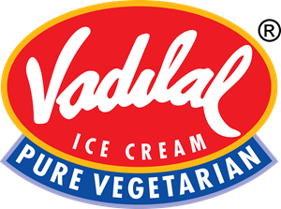

COMPETITIORS
ANALYSIS
Feature | Havmor | Amul | Kwality Walls | Vadilal
Product Range | Diverse, regional strengths (Mango Mania, Kaju Barfi), focus on innovation (World Cone, Dairy-free options) | Widest range, affordable options, classic flavors (Nutrela, Amul Scoop), strong rural presence | Premium offerings, international flavors (Cornetto, Magnum), focus on indulgence and trends | Regional favorites (Rose Petal Scoop, Gulkand), value-for-money, traditional Indian flavors
Margins | Moderate, varying across product categories | High due to strong brand recognition and established distribution network | Lower due to premium ingredients and marketing costs | Moderate, depends on region and product mix
Marketing Campaigns | Regional focus, digital marketing initiatives, influencer collaborations | National TV ads, celebrity endorsements, rural marketing campaigns | Digital-first approach, social media engagement, experiential activations | Regional advertising, local festivals and events, nostalgia-based campaigns
Top-of-Mind (TOM) Product | Mango Mania, Kwality Walls Cornetto | Havmor Mango Mania, Amul Classic Vanilla | Cornetto, Kwality Walls Classic Sundae | Gulkand Ice Cream, Vadilal Chaaswala
Upcoming Product Launch | Dairy-free Ice Cream Bars | New range of fruit-based sorbets | Magnum Chocolate Truffle variant | Seasonal flavored scoops and bars
Image | Family-friendly, regional appeal, innovative spirit | Trustworthy, affordable, nostalgic | Premium, trendy, international | Traditional, value-for-money, nostalgic

Slide 4

PRIMARY RESEARCH
Google form – 74 Response collected across 5 universities- Dtu , Nsut ,IIT-D, igdtuw , Jamia Millia Islamia
Key results from google form responses
Highest % of people lies in 18-24 age group with
96%
Among all the responses Male were 78%
55% people likes to prefer receiving desserts as a gift during Diwali
Ice cream & Soan papdi remains equal on more appealing as a Diwali gifts
Only 12% people received ice cream as a Diwali gift

Slide 5
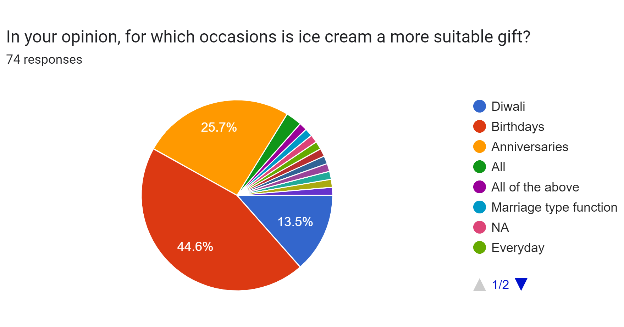
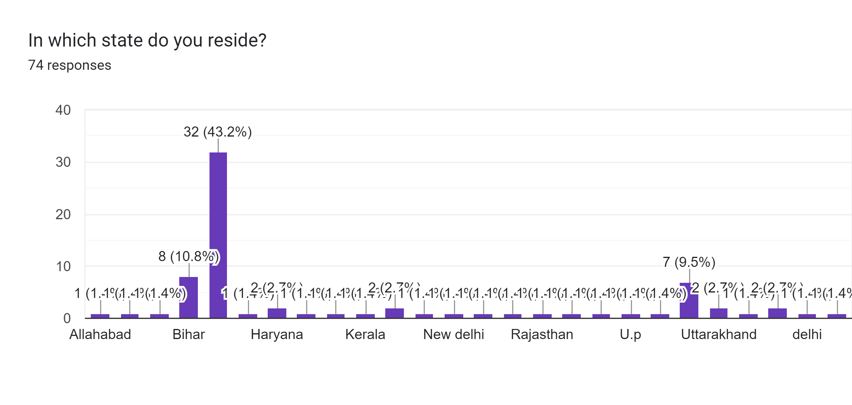
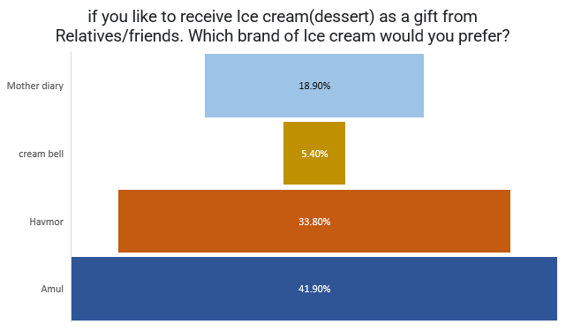
Key results from these graphs
Amul is most preferred ice cream brand with 41.9% followed by Havmor with 33.8% people like to receive ice cream as a gift from relative
44.6% people like to receive ice cream as a gift on the occasion of Birthday followed by anniversaries and Diwali with 25.7% & 13.5% respectively

